Slide 1
MARYLAND DEPARTMENT
OF
JUVENILE SERVICES
PROPOSED FEMALE DETENTION CENTER

Slide 2
NOTIFICATIONS
Written Notice
To
Carroll County Board of Commissioners
Carroll County Senator and Delegate
Howard County Executive
Howard County Senator and Delegates

Slide 3
FEMALE DETENTION DEMOGRAPHICS
Status: pre-dispositional and post-dispositional (pending placement)
Age: 12 -17
Admissions: 975 (FY 2012)
Average length of stay: 23 days (FY 2012)
Average daily population: 46 (FY 2012)

Slide 4
SERVICES OFFERED
Education
Dietary
Somatic Health
Behavioral Health
Recreation

Slide 5
SITE CHARACTERISTICS
Address:
  7960 Henryton Road, Marriottsville, MD 21104
Acreage:
  Total of 7 acres
  Adjacent to Patapsco State Park

Slide 6
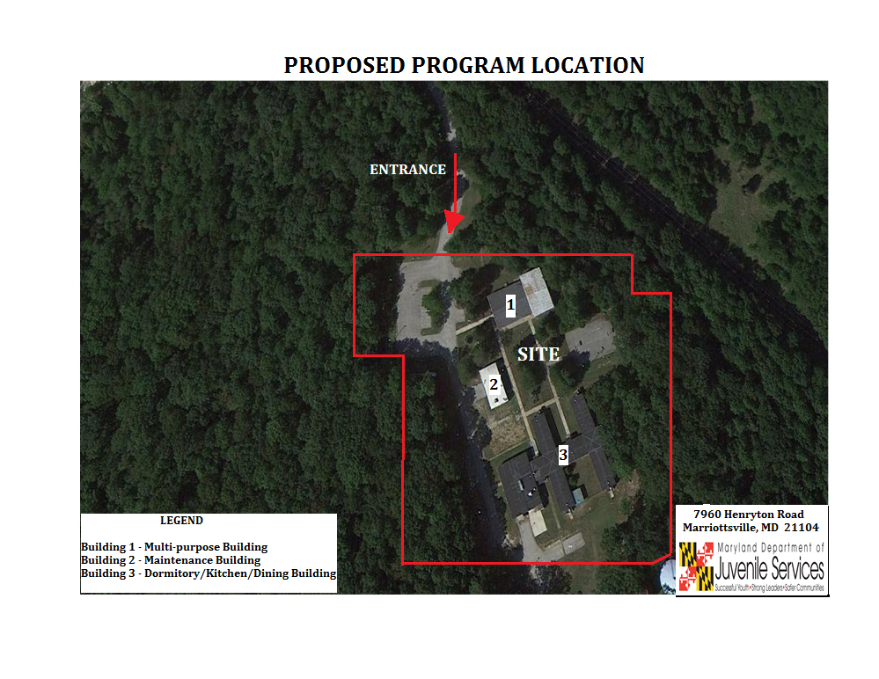

Slide 7
BUILDING CHARACTERISTICS
One story, self-contained leadership in energy and environmental design (LEED) building
Gross square footage (GSF) = 88,600
Three layers of security
  Secure site perimeter
  Building exterior perimeter
  Secure interior perimeter

Slide 8
STAFFING
126 Department of Juvenile Services Employees
Salary Range: $31,000 – $92,000
14 Maryland State Department of Education (MSDE)Employees
Administrative Aide
Food Service Worker
Registered Charge Nurse
Assistant Superintendent
Group Life Manager I
Resident Advisor I
Behavioral Health Director
Group Life Manager II
Resident Advisor Lead
Case Management Specialist
Maintenance Chief
Resident Advisor Supervisor
Case Manager Supervisor
Management Associate
Staff Training Coordinator
Clinician
Nurse Practitioner
Superintendent
Cook
Nursing Supervisor
Supply Officer
Food Service Manager
Psychologist
Transportation Officer
Food Service Supervisor
Recreation Specialist
Guidance Counselor
Teacher
Principal
Teacher’s Aide

Slide 9
ESTIMATED COSTS
AND
PLANNED SCHEDULES
Design - $4,282,000 – FY 2014 & 2015 (Aug. 2013 – Feb. 2015)
Construction - $46,704,000 - FY 2016 & 2017 (Jun. 2015 – Jun. 2017)
Furniture/equipment - $2,159,000 - FY 2018 (Feb. 2017 – Aug. 2017)
Occupancy - FY 2018 (Aug. 2017)
Operating Budget - $7,155,035 (Upon Occupancy)

Slide 10
COMMUNITY EFFORTS
Foster positive relationships with local community by creating an advisory board with community participation;
Partner with local businesses and community outreach organizations to mentor youth;
Continue the positive relationship with the Carroll County Youth Services Bureau, which already provides mental health services to the Silver Oak Academy and may be able to provide services for the young women at the proposed facility;
Schedule 2 public meetings to engage neighboring residents; Meetings will be advertised via newspaper, DJS website, and direct mailings to neighboring community's residents.

Slide 11
QUESTIONS

